Slide 1


Integrative Task 2
Andres Arango
Jhonatan Castaño

Slide 2
Introduction
Objective: Build a sentiment analysis model using supervised learning with vanilla Recurrent Neural Networks and LSTM
Secondary Objectives:
Create a database with sentences and the type of sentiment of itself.
Tokenize the sentences to find a way to build a supervised learning model.
Implement a DummyClassifier for the model.
Implement a vanilla RNN sentiment analysis model.
Implement a LSTM sentiment analysis model.

Slide 3
Methodology
Define the problem
Gather Data
Explore and prepare data
Feature Engineerin
Split the Data
Choose a Model
Train the Model
Evaluate Model
Hyperparameter Tuning
Deploy

Slide 4
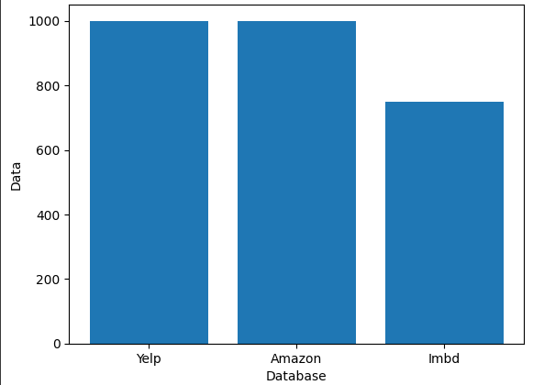
Data From Each of the Databases

Slide 5
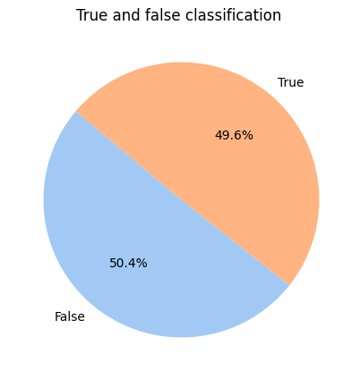
Clasiffication

Slide 6
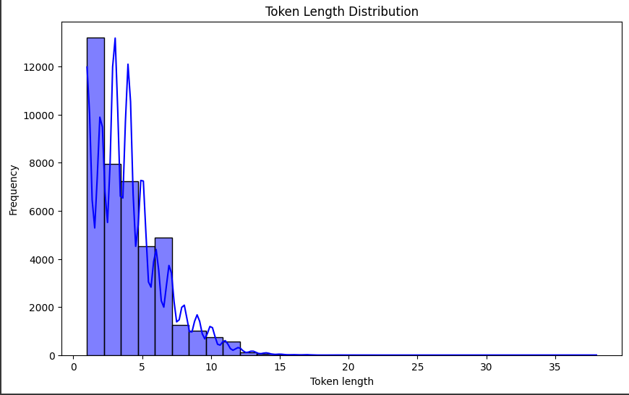
Token length Distribution

Slide 7
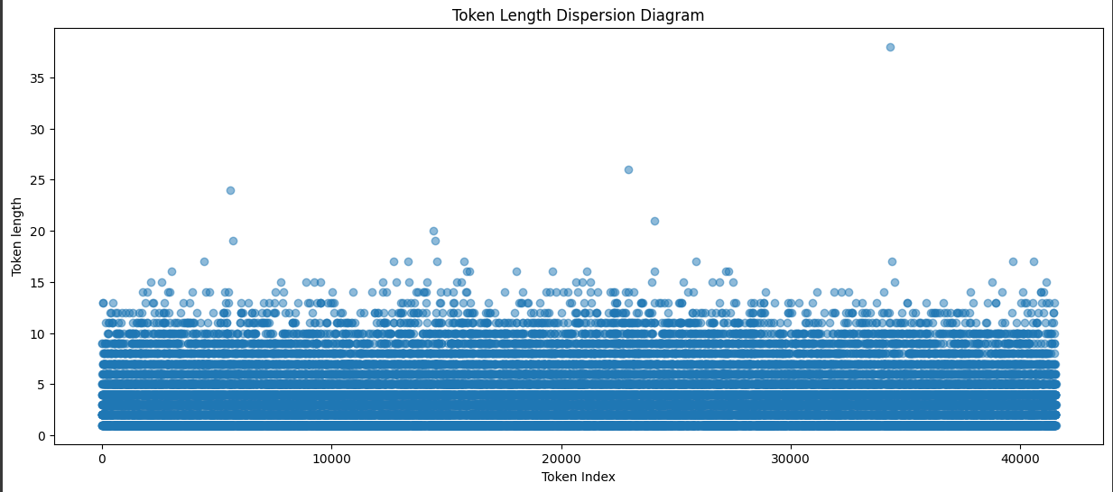
Token length Dispersion

Slide 8
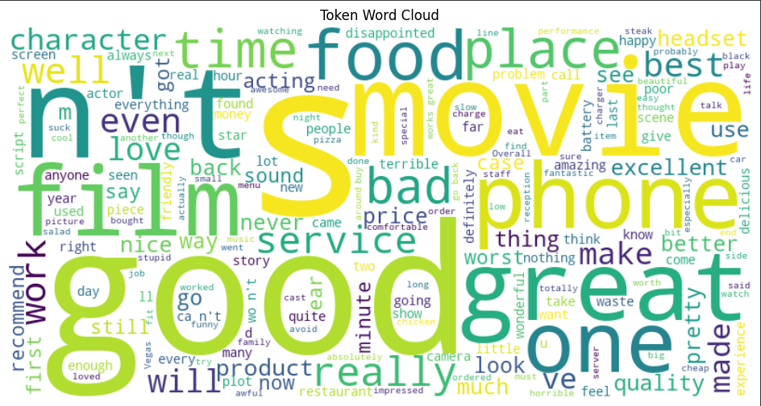
Token Word Cloud

